Slide 1
Fertilizers Recommendation System for Disease Prediction
USING DEEP LEARNING
Team name : TECH_GREENZZ

Slide 2

IDEA ABOUT THE STATEMENT
Agriculture is the most important sector in today’s life. Most plants are affected by a wide variety of bacterial and fungal diseases. Diseases on plants placed a major constraint on the production and a major threat to food security. Hence, early and accurate identification of plant diseases is essential to ensure high quantity and best quality. In recent years, the number of diseases on plants and the degree of harm caused has increased due to the variation in pathogen varieties, changes in cultivation methods, and inadequate plant protection techniques. An automated system is introduced to identify different diseases on plants by checking the symptoms shown on the leaves of the plant. Deep learning techniques are used to identify the diseases and suggest the precautions that can be taken for those diseases.

Slide 3
PROJECT DESCRIPTION
Agriculture is the most important sector in today’s life. Most plants are affected by a wide variety of bacterial and fungal diseases. Diseases on plants placed a major constraint on the production and a major threat to food security. Hence, early and accurate idendification of plant diseases is essential to ensure high quantity and best quality.
In recent years, the number of diseases on plants and the degree of harm caused has increased due to the variation in pathogen varieties, changes in cultivation methods, and inadequate plant protection techniques. An automated system is introduced to identify different diseases on plants by checking the symptoms shown on the leaves of the plant. Deep learning techniques are used to identify the diseases and suggest the precautions that can be taken for those diseases.

Slide 4
PROJECT OBJECTIVES:
To preprocess the images.
Applying the CNN algorithm to the dataset.
How deep neural networks detect the disease.
You will be able to know how to find the accuracy of the model.
You will be able to build web applications using the Flask framework.

Slide 5

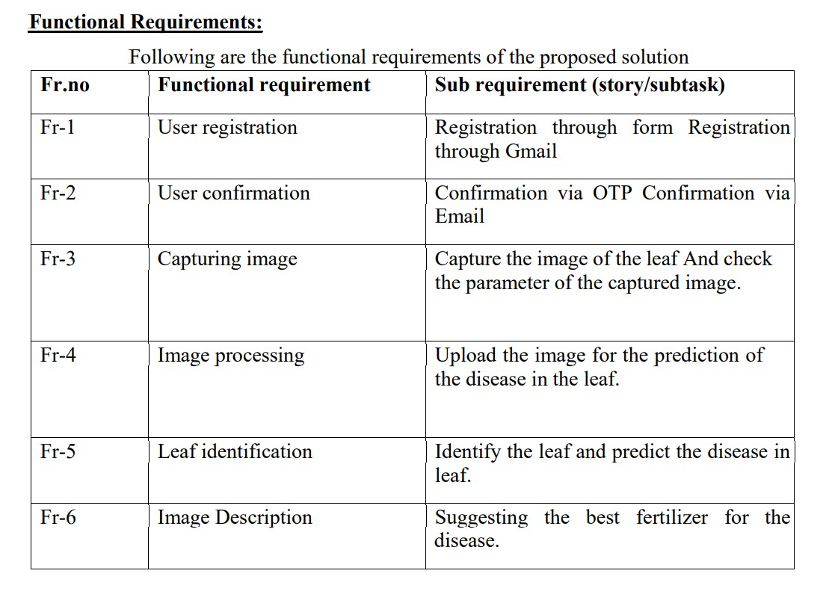
FUNCTIONAL REQUIREMENTS:

Slide 6

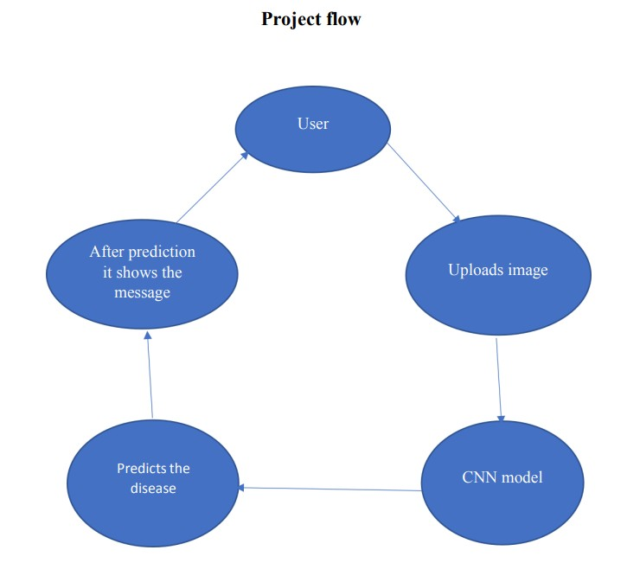
PROJECT FLOW

Slide 7
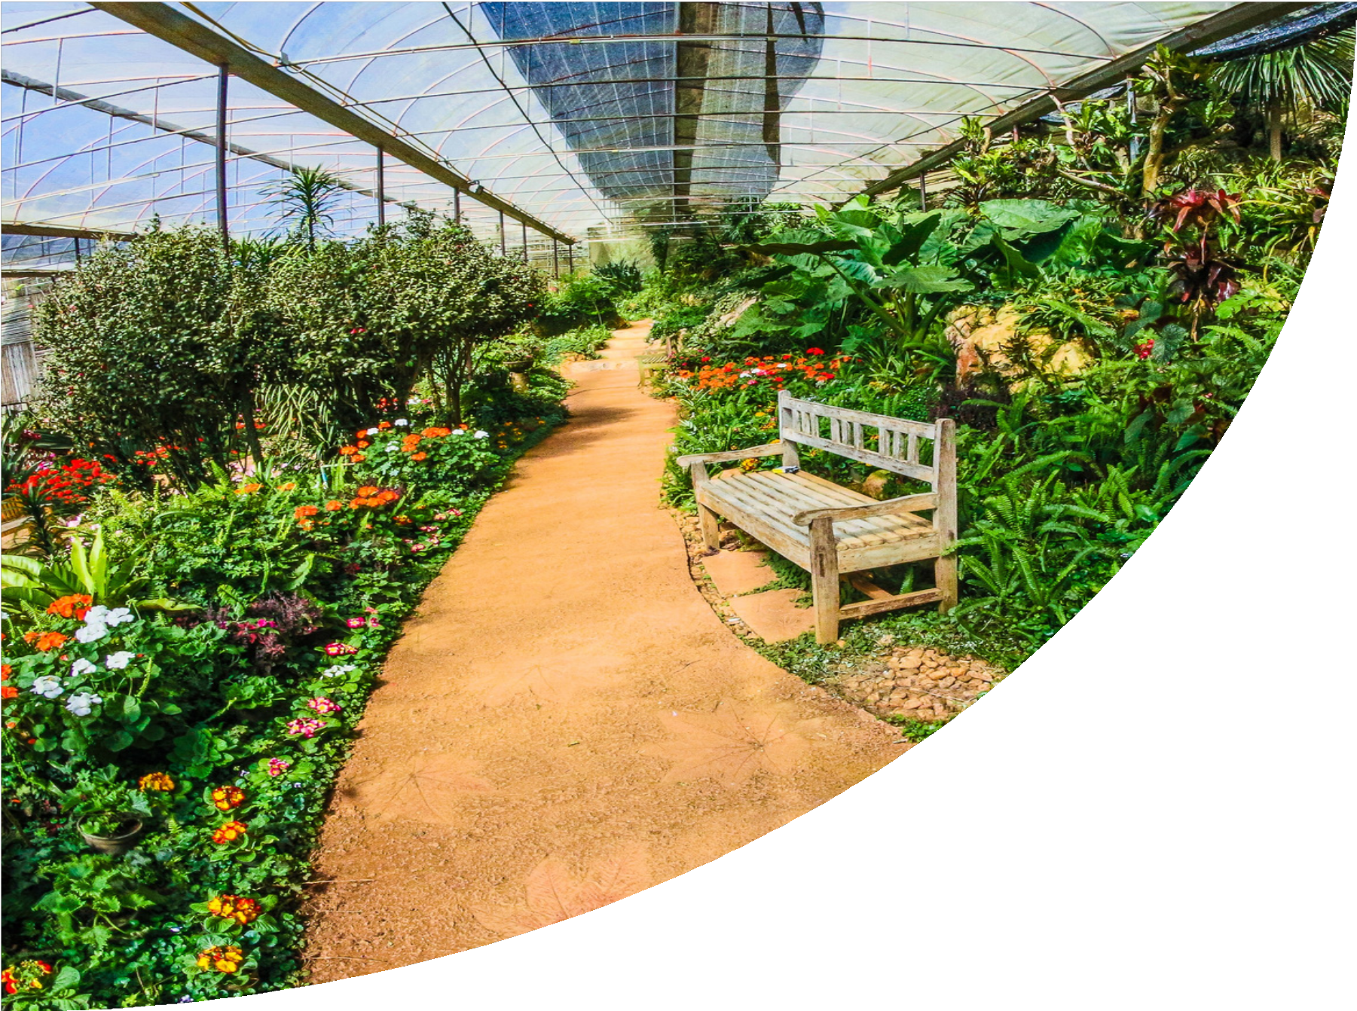
PROJECT DESIGN PHASE
01.
1.DATA COLLECTION: Data collection is the most efficient method for collecting and measuring the data from different resources like kaggle and UCI machine learning repository. To get an approximate dataset for the system. This dataset must contain the following attributes i.) Images of fruit diseases ii.) Images of vegetable diseases etc., in which those parameters will be considered for disease prediction.
4. FERTILIZER RECOMMENDATION:
To Predict the particular fertilizer to be used, we use input parameters like N,P,K temperature, humidity,
moisture and soil type and also crop to be grown. Fertilizer prediction process begins with the loading of
the external fertilizers datasets. Once the dataset is read then pre-processing will be done by various
stages as discussed in the Data Pre-processing section.
After the data pre-processing, train the models using SVM,
Random Forest classifier into training dataset. For a prediction of the fertilizers, we consider various factors such as temperature, humidity, soil PH and predicted crop to be grown
03.
3. DEEP LEARNING ALGORITHM FOR PREDICTION:
Machine learning predictive algorithms have highly optimized estimation that has to be a likely outcome based on trained data. Predictive analytics is the use of data, statistical algorithms and machine learning techniques to identify the likelihood of future outcomes based on historical data.
04.
02.
2. DATA PRE-PROCESSING:
After collecting datasets from various resources. Dataset must be pre-processing before training the model. The data pre-processing can be done by various stages, beginning with reading the collected
dataset the process continues to data cleaning. In data cleaning the datasets contain some redundant attributes, those attributes are not considered for disease prediction. So, we have to drop unwanted attributes and datasets containing some missing values. We need to drop these missing values or fill them with unwanted values in order to get better accuracy. Then define the target for a model. After data cleaning the dataset will be split into training and test sets by using specific libraries

Slide 8

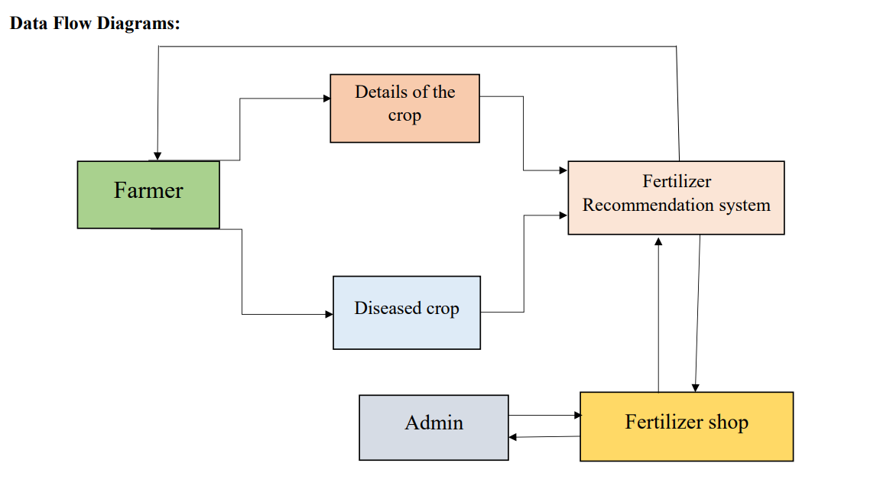
project data flow

Slide 9
MODULES:
Crop Recommendation
Fertilizer Recommendation
Disease Identification and Prevention Measures

Slide 10
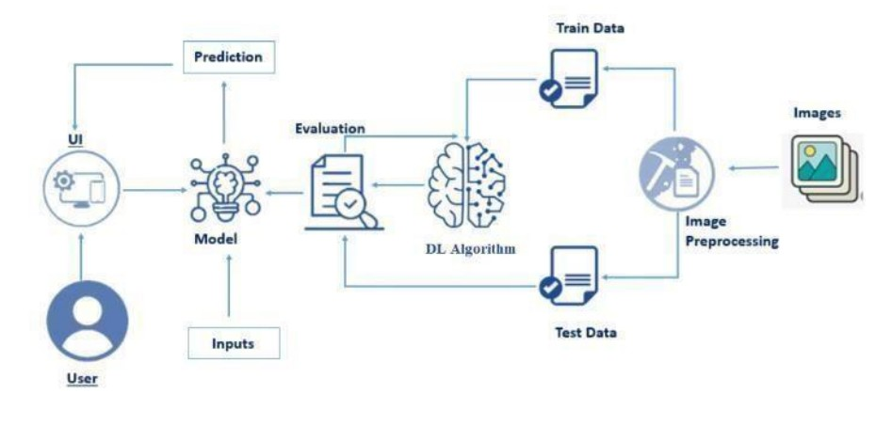
SOLUTION ARCHITECTURE

Slide 11
Thank you!
.

